Slide 1

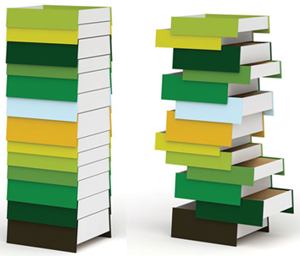
Stacks
Real Life Examples
Shipment in a Cargo
Plates on a tray
Stack of Coins
Stack of Drawers
Shunting of Trains in Railway Yard
Follows the Last-In First-Out (LIFO) strategy
1

Slide 2
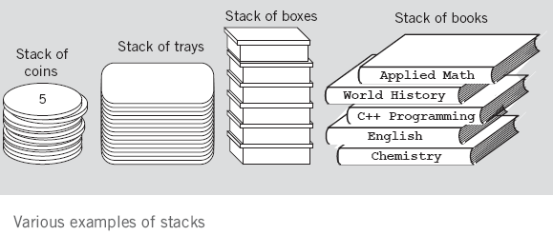
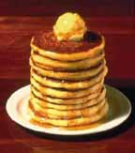
Stack Examples

Slide 3
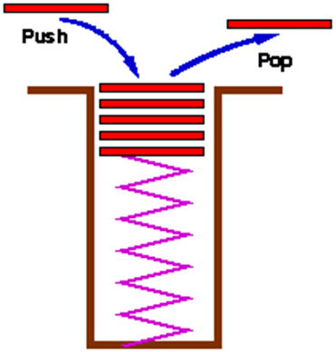
Stack
An ordered collection of homogeneous data elements where the insertions and deletions take place at on end only called Top
New elements are added or pushed onto the top of the stack
The first element to be removed or popped is taken from the top - the last one in

Slide 4
Stack Operations
A stack is generally implemented with only two principle operations
Push adds an item to a stack
Pop extracts the most recently pushed item from the stack
Other methods such as
Top returns the item at the top without removing it
Isempty determines whether the stack has anything in it

Slide 5
Common Stack Operations
MAKENULL(S): Make Stack S be an empty stack.
TOP(S): Return the element at the top of stack S.
POP(S): Remove the top element of the stack.
PUSH(S): Insert the element x at the top of the stack.
ISEMPTY(S): Return true if S is an empty stack; return false otherwise.

Slide 6
Stack – Array Implementation
First Implementation
Elements are stored in contiguous cells of an array.
New elements can be inserted to the top of the list
top
First Element
Second Element
List
Last Element
Empty
maxlength

Slide 7

Stack – Array Implementation

Slide 8
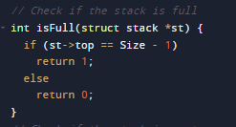
Is Full ()

Slide 9
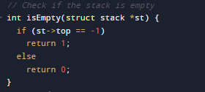
Is Empty()

Slide 10
Stack Operations

Slide 11
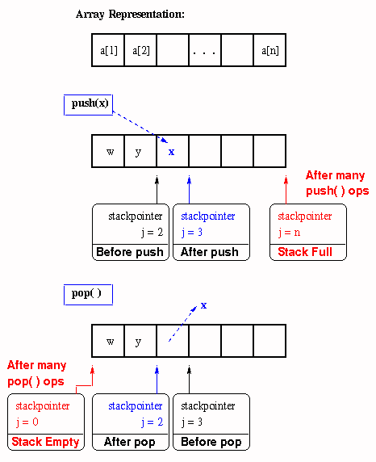
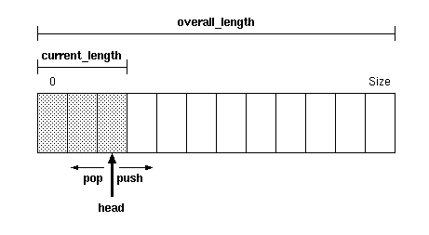
Push and Pop Trace

Slide 12
Push– Array Implementation
4
3
2
1
0
4
4
4
4
top
4
5
3
3
3
top
3
4
3
4
2
2
top
2
9
2
9
2
9
Push 8
Push 9
Push 7
Push 4
Push 5
1
1
8
1
8
1
8
1
8
top
top
0
7
0
7
0
7
0
7
0
7
Empty stack
StackSize = 5
top = -1
top = StackSize – 1,
Stack is full,
We can’t push more elements

Slide 13
Push – Array Implementation
push(Stack[],element)
{
if (top == StackSize – 1)
cout<<“stack is full”;
else
Stack[++top] = element;
}

Slide 14
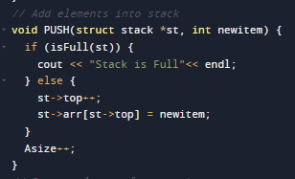
Push – Array Implementation

Slide 15
Pop – Array Implementation
top
4
3
2
1
0
4
5
4
4
4
4
3
4
top
3
4
3
3
3
2
9
2
9
top
2
9
2
2
Pop
Pop
Pop
Pop
Pop
1
8
1
8
1
8
1
8
1
top
0
7
0
7
0
7
0
7
top
0
7
Empty stack top = -1
We can’t pop more
elements
top = StackSize – 1,
Stack is full,
We can’t push more elements.

Slide 16
Pop – Array Implementation
pop( Stack[])
{
if (top == –1)
cout<<“stack is empty”;
else
return Stack[top--];
}

Slide 17
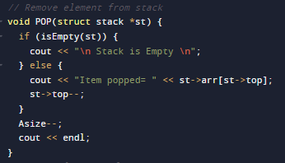
Pop – Array Implementation

Slide 18
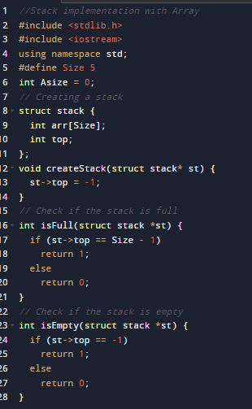
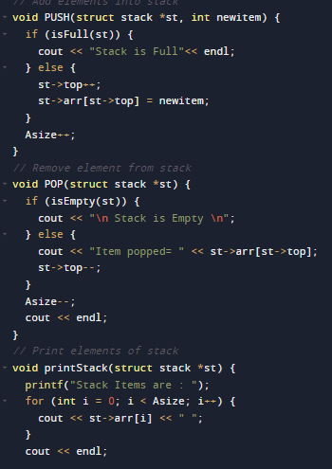
Complete Program

Slide 19
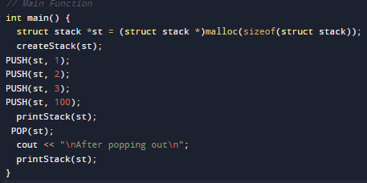
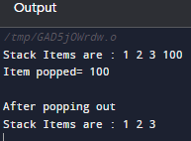
Complete Program

Slide 20
Stack – Linked Representation
PUSH and POP operate only on the header cell and the first cell on the list
struct Node{
int data;
Node* next;
} *top;
top = NULL;
Top
7
8
9

Slide 21

Stack – Linked Representation

Slide 22
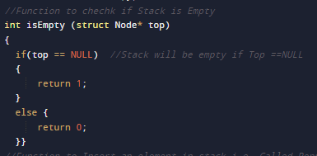
IS Empty() – Code Snippet

Slide 23
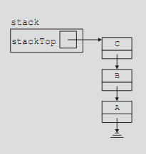
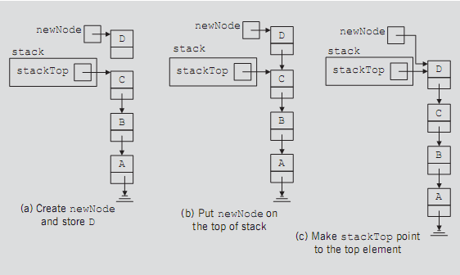
Push Operation - Trace

Slide 24
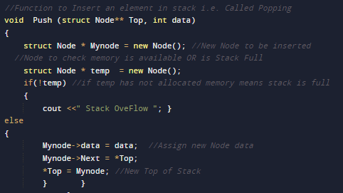
Push operation

Slide 25
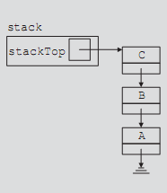
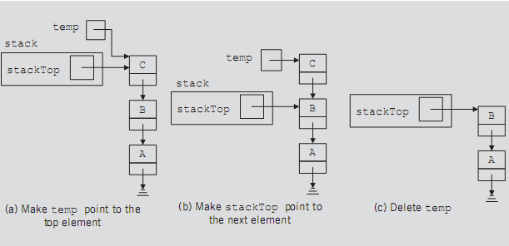
Pop Operation - Trace

Slide 26
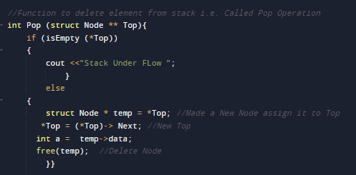
Pop Operation

Slide 27
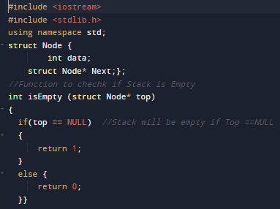
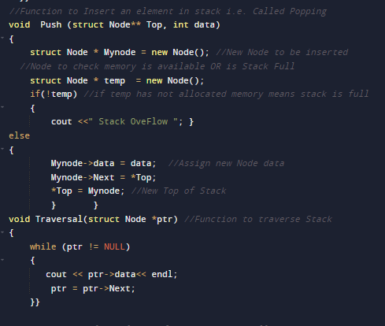
Complete Code

Slide 28
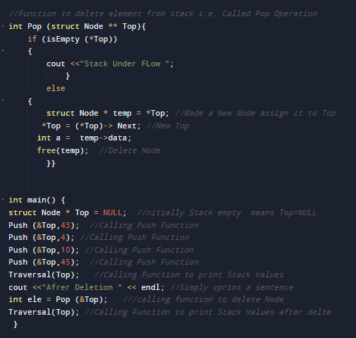
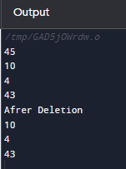
Complete Code

